Slide 1
Quarto & HTML Widgets
CSCI 444

Slide 2



What is Quarto?
Quarto is the next generation of R Markdown
Framework to combine
code
data
text
interactive charts

Slide 3





Markdown
Language developed in 2004
John Gruber and Aaron Swartz
Wanted to markup blogs without writing html
Markdown used to format text
Github
Reddit
StackExchange
Trello
Airbnb (R Markdown)

Slide 4




Quarto Components
htmlwidgets::saveWidget(m, "temp.html", selfcontained = FALSE) webshot("temp.html", file = "m.png", cliprect = "viewport")
CRAN repository packages
quarto → creates markdown files (.qmd extension)
rmarkdown → also installs knitr
tinytex → easily outputs pdf files in markdown
> tinytex::install_tinytex() → run after package installed (you may be warned that there will be 2 errors on installation)
> tinytex::reinstall_tinytex() → to correct tlmgr errors
> tinytex:::is_install() → returns TRUE if tinytex installed
NOTE: There are THREE colons ( : ), not two
Should remove html code chunks
kableExtra → creates tables in R Markdown
reticulate → run python code chunks

Slide 5




Quarto Markdown
Developed by Posit as a next generation Rmarkdown
RStudio already bundles Pandoc → required for Quarto
Pandoc is a Haskell library for converting one markup format to another: e.g., Markdown to HTML or LaTex or Word
Quarto cheatsheet
Easily convert .qmd files
html
pdf
Word
PowerPoint

Slide 6
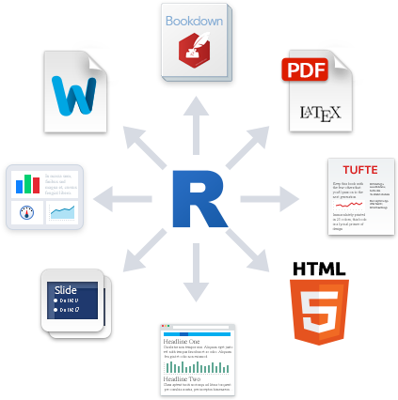
Quarto Template
Quarto Template
Header – metadata for Quarto
Text – Pandoc-flavored Markdown
Code Chunks – R code that is run when file knitted
Click Render button

Slide 7

Rendering in Quarto
knitr engine executes all of the code chunks
Processed by pandoc to create file format
Markdown file created

Slide 8
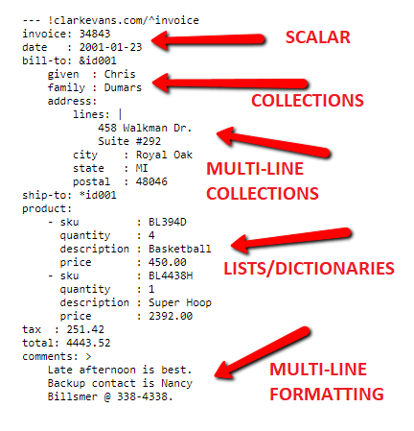
Header
Other formats
html
pdf or beamer
Need tinytex package
pptx (PowerPoint)
docx (Word)
Metadata of Quarto
YAML → YAML Ain’t Markup Language
Indentation matters!!!
Renders parameters, including file type
knitr or jupyter engine
--- title: "Unit_11" format: revealjs editor: visual ---
https://quarto.org/docs/presentations/revealjs/
https://quarto.org/docs/presentations/
https://quarto.org/docs/get-started/hello/rstudio.html https://quarto.org/docs/get-started/authoring/rstudio.html

Slide 9
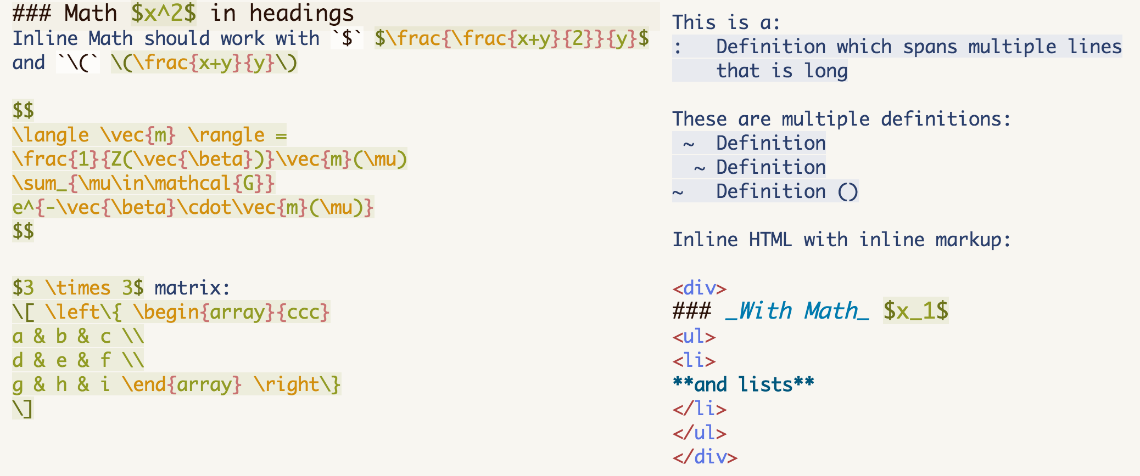
Text
Pandoc-flavored Markdown
NOTE 1: Begin text section with a BLANK LINE to start on new line NOTE 2: symbol followed by a SPACE exception: italics, bold, inline-code
*italics*
**bold**
`inline code`
# first-level header
## second-level header
### third-level header
revealJS: Use headers (#), or --- to create slides
- bulleted list, item 1 - bulleted list, item 2 - bulleted list, sub-point of item 2
1. numbered list, item 1 2. numbered list, item 2
> beginning of block-quote actual text of quote > ending of block-quote
``` text displayed verbatim ```
$ inline LaTeX for math equations $$ math expressions $$
revealJS: Displays list on click ::: {.incremental}
List within div (:::)
:::
Note the space after the last #

Slide 10


Text con’t - Graphics
Pandoc (and therefore R Markdown) supports png and jpg graphics
![text with image](image location)
![Smiley Face](img/smiley.jpg)
![ ](img/smiley.png)
![ ](img/smiley.png){#id .class width=50% height=50%}
Supports px, cm, mm, in, inch, and %
No text displayed

Slide 11
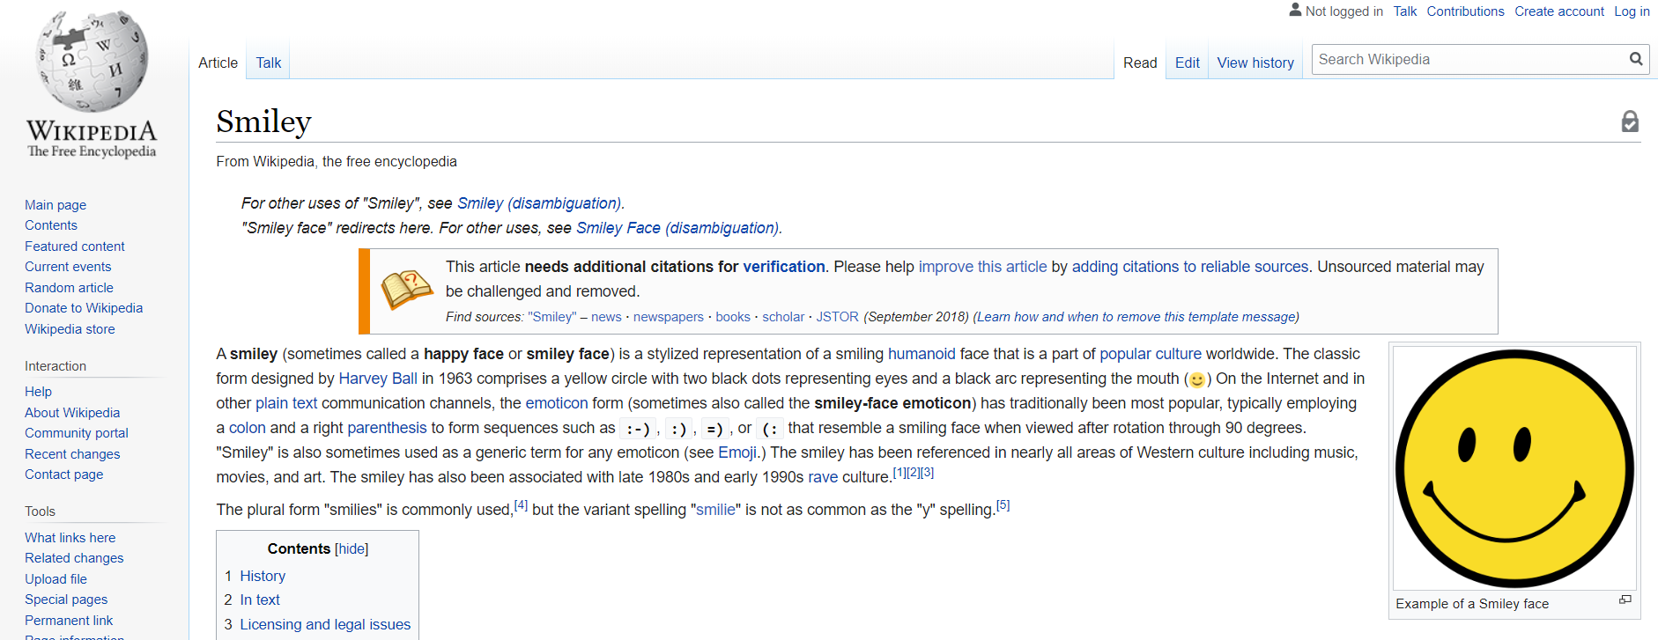
Text con’t - URLs
<URL>
<https://en.wikipedia.org/wiki/Smiley>

Slide 12
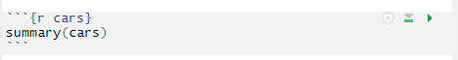

Code Chunks
R code that is run when file knitted
Click Render button
Each chunk can be run on its own by clicking Run button
Use #| to designate YAML
Name of code chunk
Can specify options for code chunks.
echo=FALSE → will NOT display code in output document (TRUE is default)

Slide 13
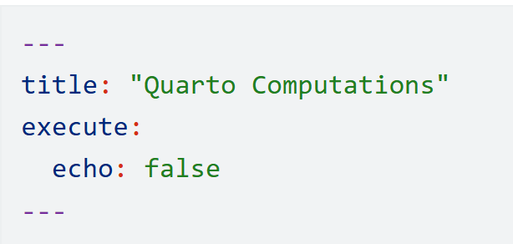
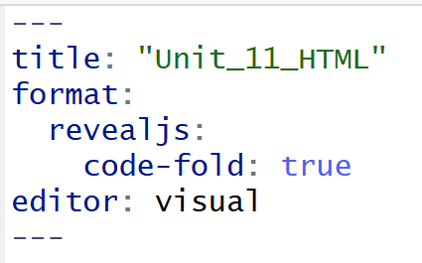
Code Chunk Options
Can also suppress or fold source code globally in YAML header.
NOTE: To fold, I also had to define echo=TRUE in each code chunk
echo → whether to echo source code (TRUE is default)
eval → whether to evaluate code chunk (TRUE is default)
results → how to handle text output (‘asis’ is default; other option: ‘hide’)
dev → graphical device (‘png’ is default; other options: ‘pdf’, ‘svg’, ‘jpeg’
warning, message & error → whether to print message (TRUE is default)
include → if eval=TRUE, source code evaluated but NOT output (TRUE is default)
cache → cache’s code and will not re-run code-chunk if unchanged (FALSE is default)

Slide 14
Code Chunk Options con’t
fig.width or fig.height or fig.dim (both) → figure dimensions in inches
fig.width = 4, fig.height = 6, OR fig.dim = c(4, 6)
out.width or out.height → figure dimensions in pixels or percentages
out.width = ‘80%’ OR out.width = ‘300px’
fig.align → specifies ‘left’, ‘center’, or ‘right’ aligned
fig.align = ‘center’

Slide 15
Inline R and other Languages
Inline R code (knitr) → `r code_here`
Code chunks may be other languages
```{python} code_here ```
Install reticulate package to run python code within R Markdown

Slide 16
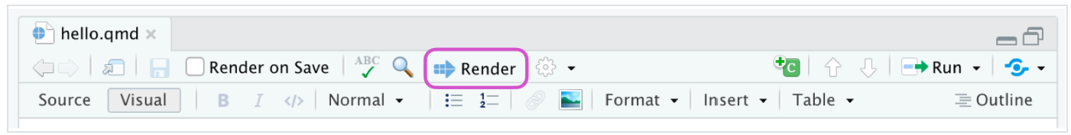
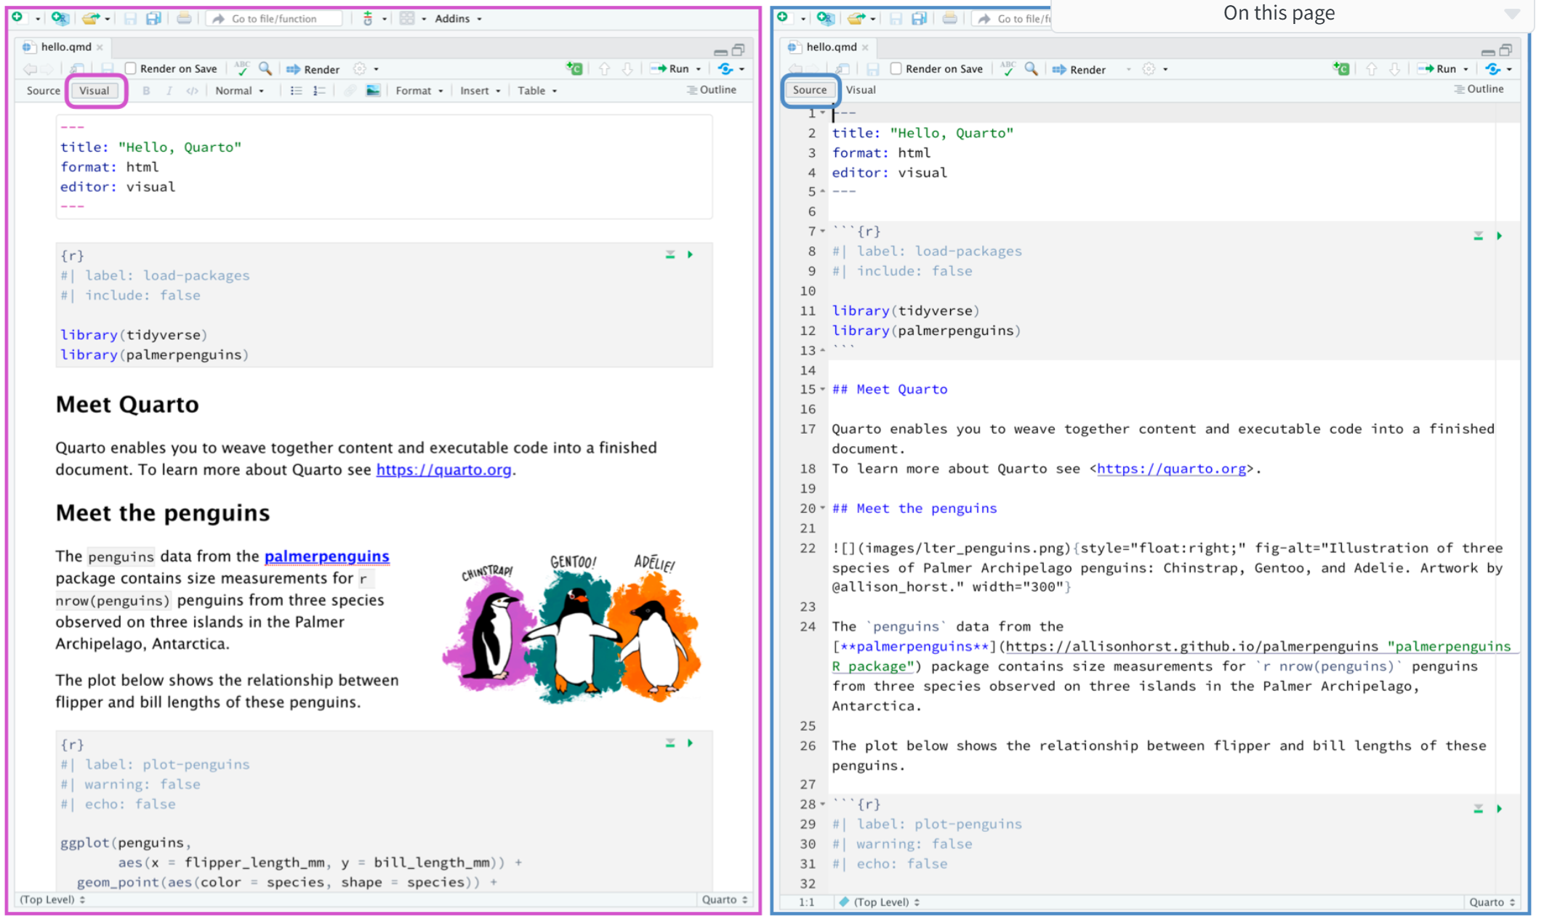
File > new File > Quarto Presentation (or Document)

Slide 17
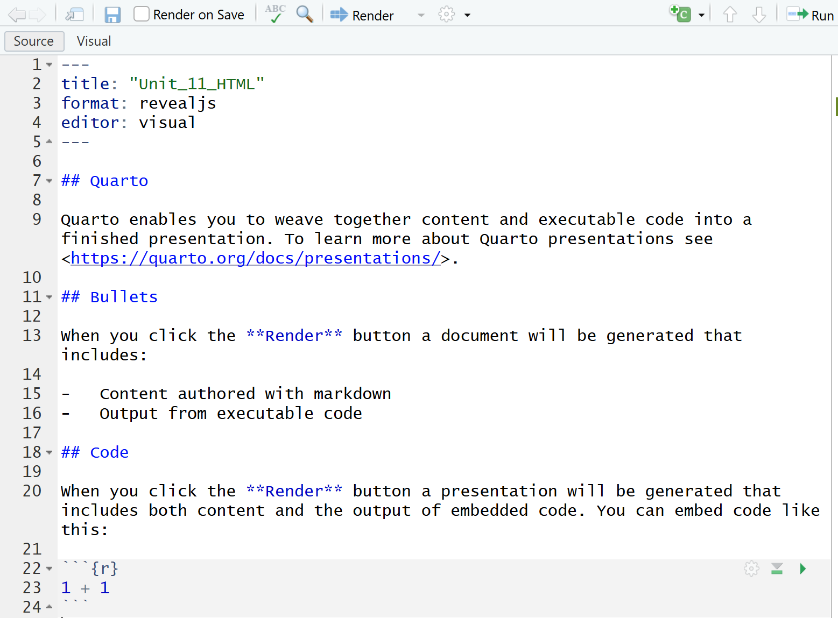
File > New File > Quarto Presentation (choose Reveal JS)
Initial Quarto file
YAML header
Delete
Add code to load libraries
```{r load-libraries} library(tidyverse) ``` ```{r load-libraries} pacman::p_load(tidyverse) ```
Source view
Markdown

Slide 18
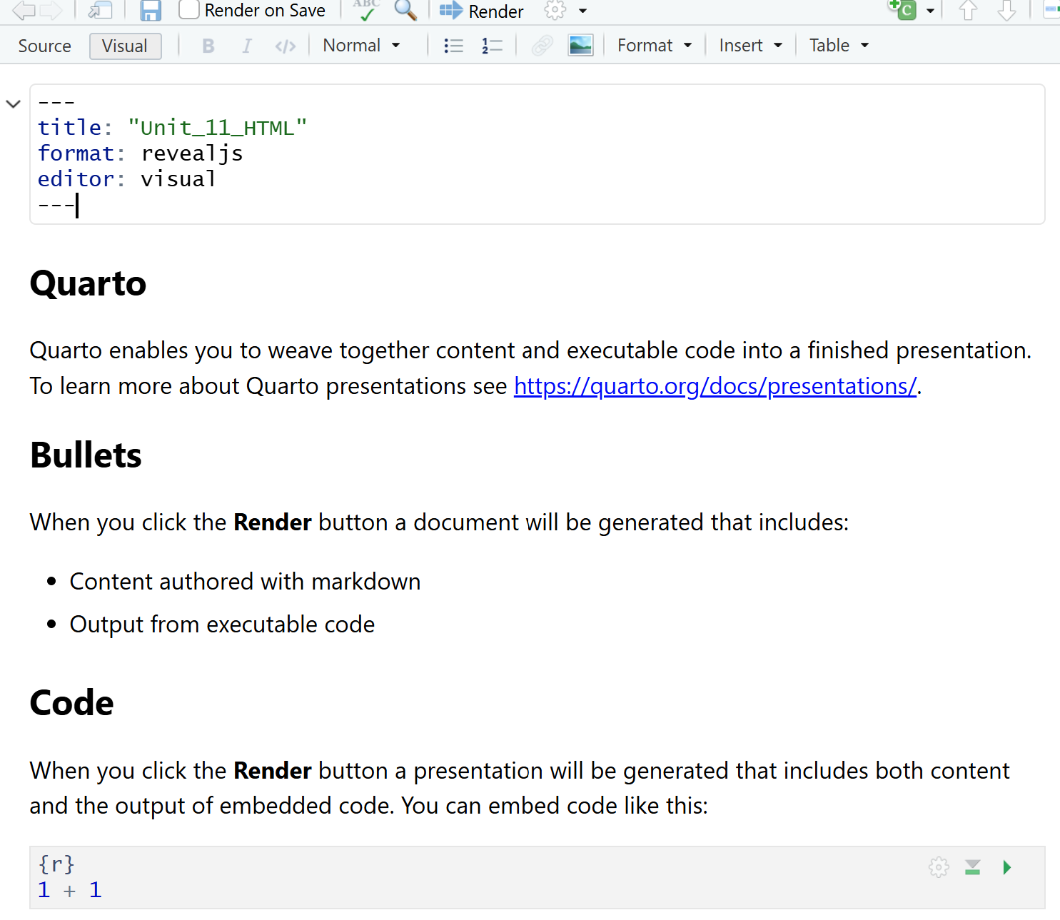
File > New File > Quarto Presentation (choose Reveal JS)
Initial Quarto file
YAML header
Delete
Add code to load libraries
```{r load-libraries} library(tidyverse) ``` ```{r load-libraries} pacman::p_load(tidyverse) ```
Visual view

Slide 19
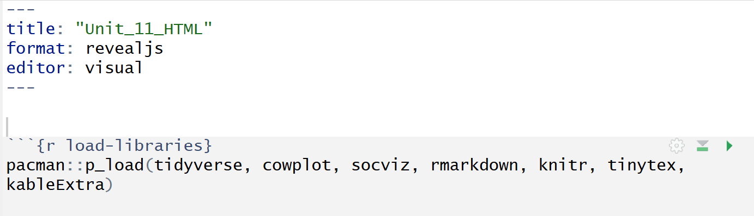
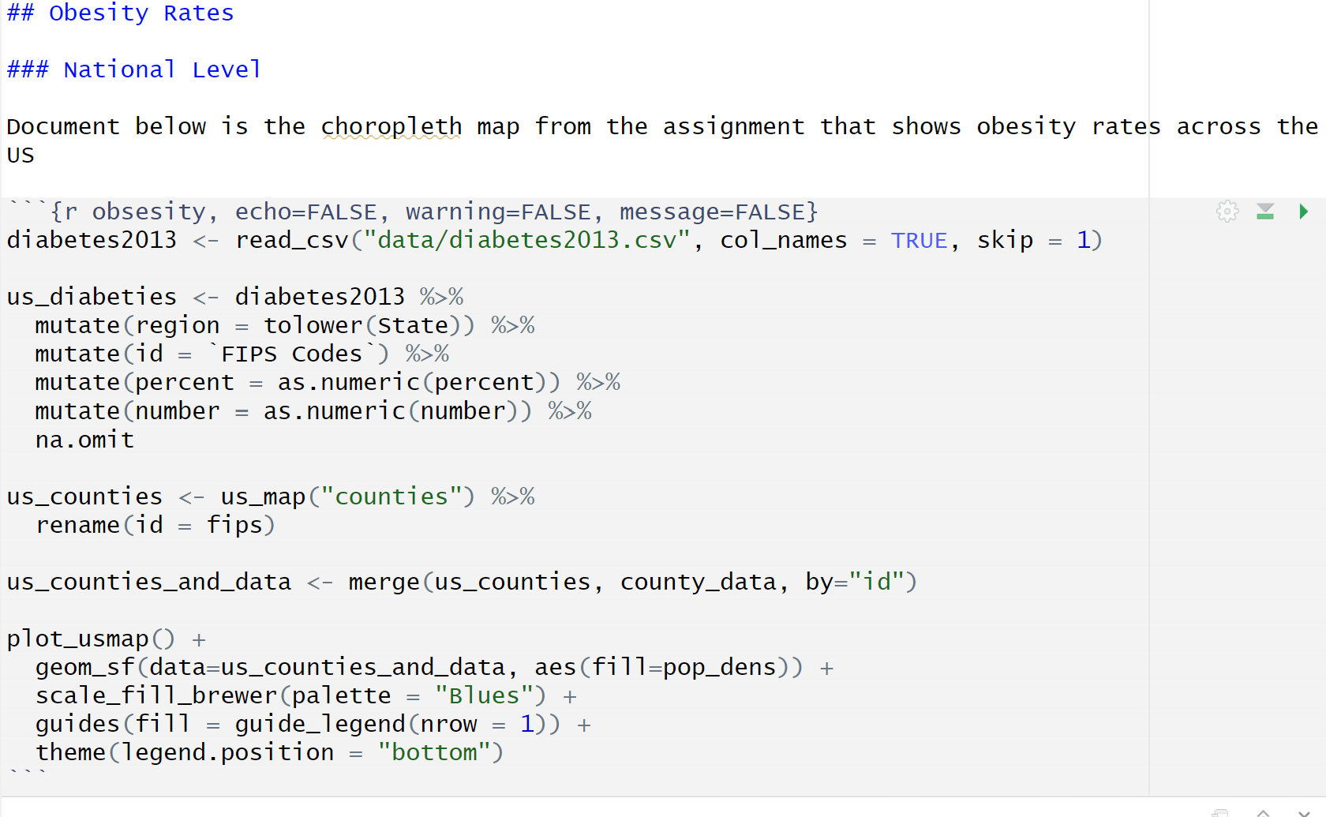
My First Markdown File With Quarto
Obesity Data National Level

Slide 20
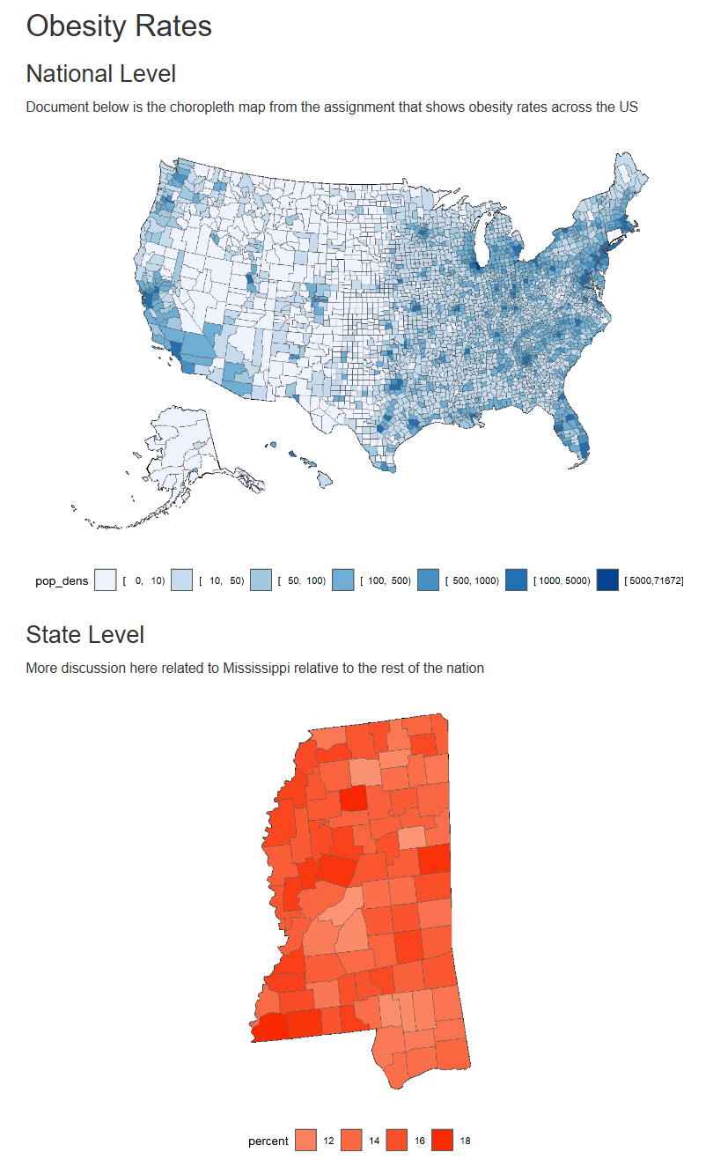
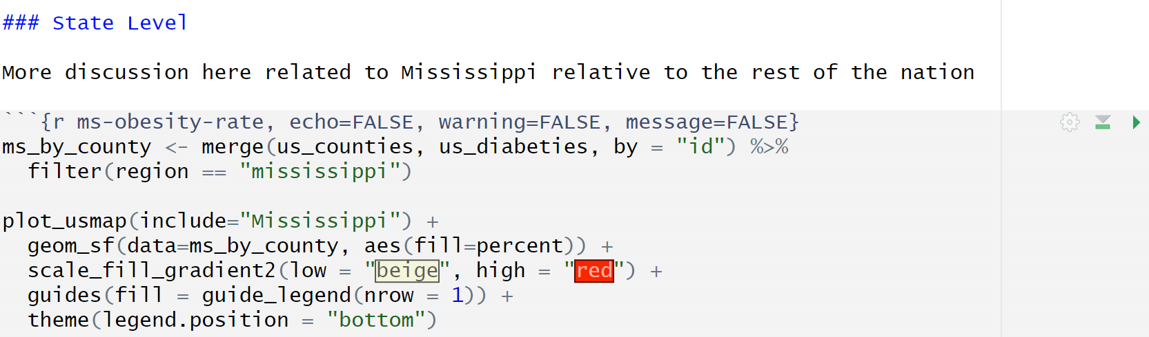
My First Markdown File With Quarto
Obesity Data
Mississippi
Generated Output (Partial)

Slide 21
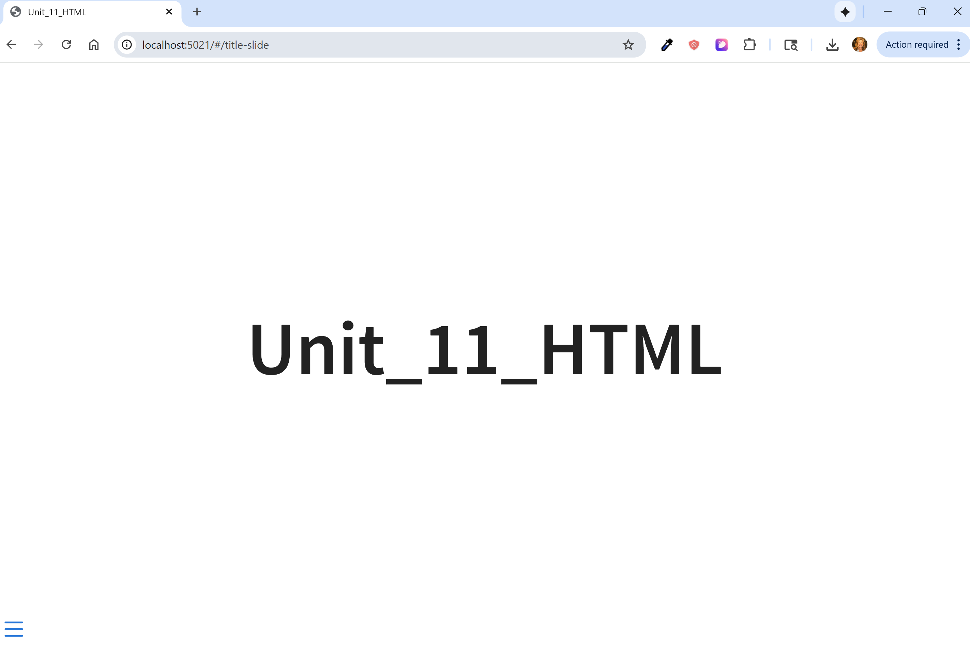
Rendered HTML
Shows slide deck

Slide 22
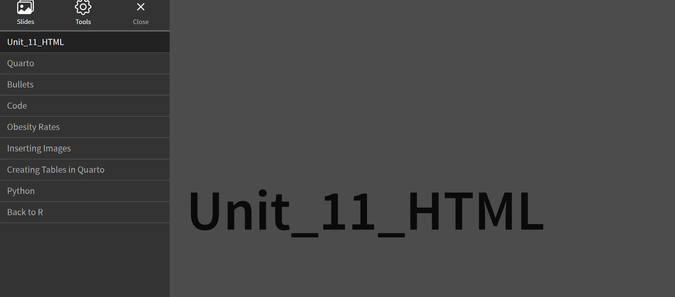
Rendered HTML

Slide 23
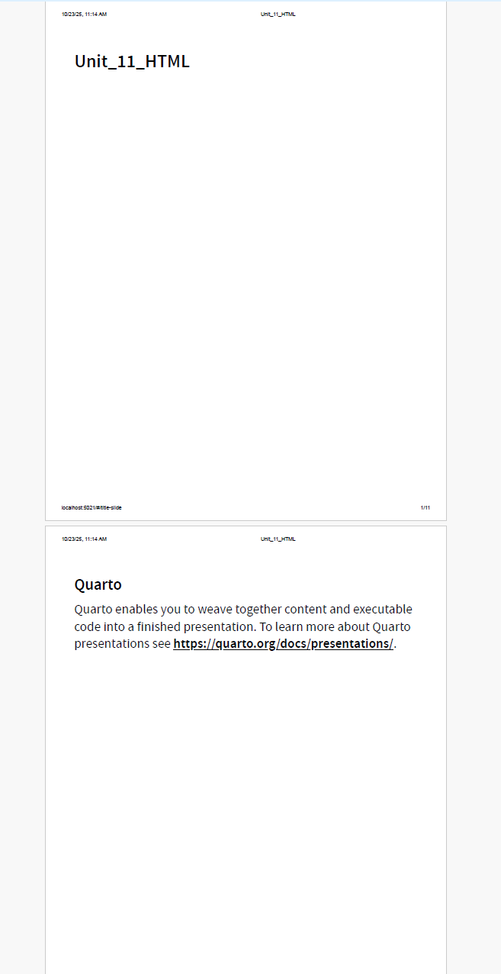
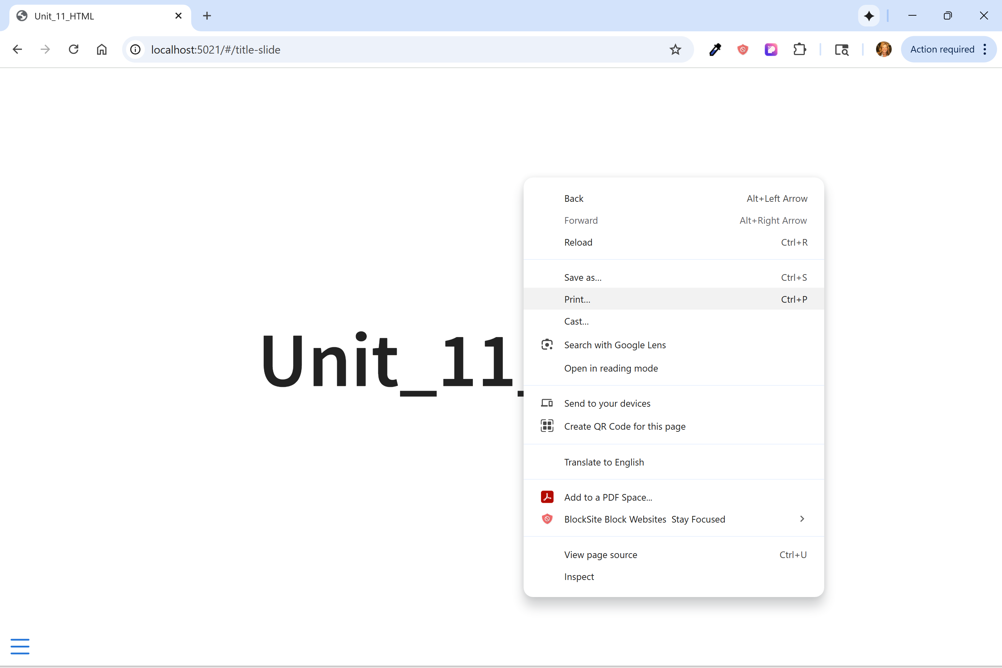
Print as PDF (reveal JS)
PDF

Slide 24

Markdown Tables
kableExtra package → prior to R 3.6.1 package was kable
tibble or data frame (df) %>% kable()
kable(align = “c”) → centers → “l” left-justifies → “r” right-justifies
tibble Variable names are table headers
Additional functions
add_header_above() → adds a header over the tibble header names
kable_styling(…) → adds bootstrap framework styling

Slide 25
Kable Styling Options
font_size = 7
column_spec & row_spec → specification for individual columns/rows → header row is at index 0
Example:
column_spec(colNumber or colStart:colLast, align = “left”, [or “center” or “right”] background = “blue” color = “white” angle = 45 bold/italic/underline/strikeout = TRUE/FALSE
kable_styling(bootstrap_options =
“striped” → rows alternate colors
“hover” → highlights on mouseover
“condensed” → slightly smaller row height
“responsive” → auto resizing scrollable for mobile devices
fixed_thead = TRUE or fixed_theader = list(enabled = TRUE, background = “red”) → table header fixed at the top

Slide 26
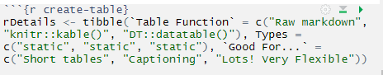
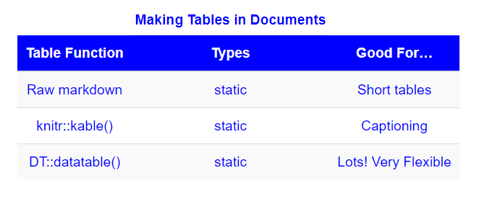
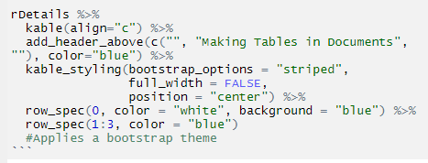
Example – Creating a Table
First define tibble
Output
Use tibble in kable function

Slide 27

HTML Widgets
HTML Widgets
Developed by RStudio
Binds JS & R
JS libraries make building charts & maps easier
Easier than D3 → must know browser

Slide 28
HTML Widget Packages
Collection of R packages to build interactive charts, maps, etc.
Library | Charts | Maps | Networks | Tables
Leaflet |  | X
DT |  |  |  | X
Plotly | X | X
Highcharter | X | X
visNetwork |  |  | X
NOTE: Highcharter NOT free for government or commercial uses

Slide 29




Leaflet HTMLwidgets
Used by Github, Washington Post, NY Times, OpenStreetMap, Flickr
Embed in RMarkdown → html_document for dynamic interaction
pdf creates a snapshot

Slide 30

Basic Leaflet
pacman::p_load(tidyverse, maps, leaflet)
mapStates = map("state", fill = TRUE, plot = FALSE) → must create a map file
mapStates %>%
leaflet() %>%
addTiles() → If no provider tile specified then OpenStreetMap is used
addProviderTiles(…) used instead of addTiles to customize
Additional examples may be found at https://bookdown.org/nicohahn/making_maps_with_r5/docs/tmap.html#related-links

Slide 31
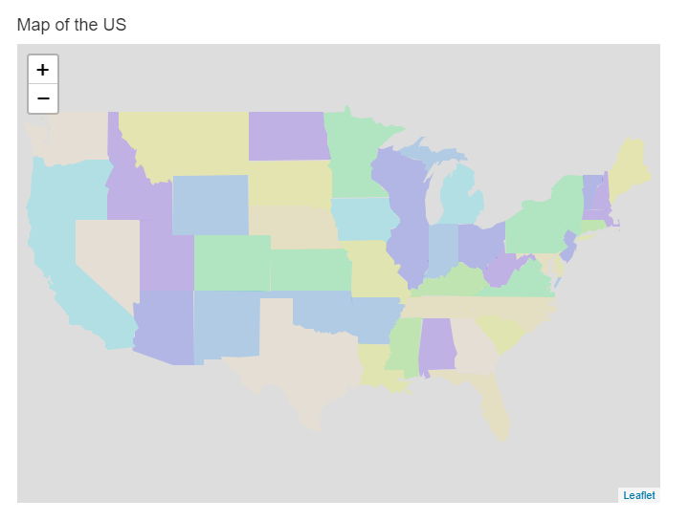
US Map Using Leaflet
#### Map of the US
```{r basic-leaflet-us, echo=FALSE}
pacman::p_load(leaflet, maps)
mapStates = map("state", fill = TRUE, plot = FALSE)
mapStates %>%
leaflet() %>%
addPolygons(fillColor = topo.colors(10, alpha = NULL), stroke = FALSE)
```

Slide 32
Adding Map Markers in Leaflet
Available markers: Map markers, Circle Markers, Line Markers
Use htmltools package to customize popups and labels using html
Use formatted string (sprintf) → %s, %f & %g

Slide 33
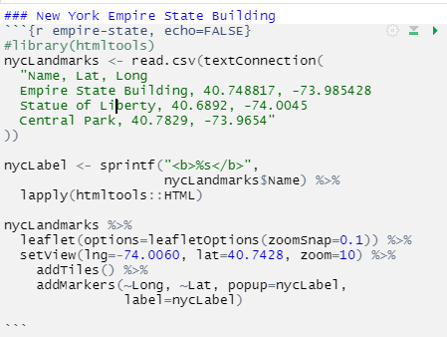
NYC Landmarks
Names of attributes followed by set of values. textConnection sets up values.
NOTE: Only an “Enter” (i.e., new line) separates each entry/observational unit NOT a comma.
Entire textConnection is enclosed in only 1 set of “” (double-quotes)
Use sprintf to format labels. Must also apply results to a “list” → lapply(htmltools::HTML)
Set the center Longitude and Latitude in which to display/view map.
Must also include a zoom. Without zoomSnap option, zoom can only be whole numbers
~ required to reference dataset’s variable.
label and popups display as defined in sprintf

Slide 34
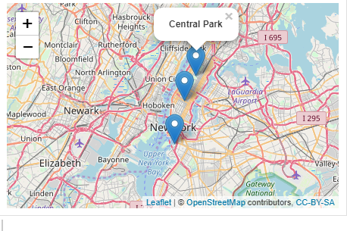
NYC Output

Slide 35
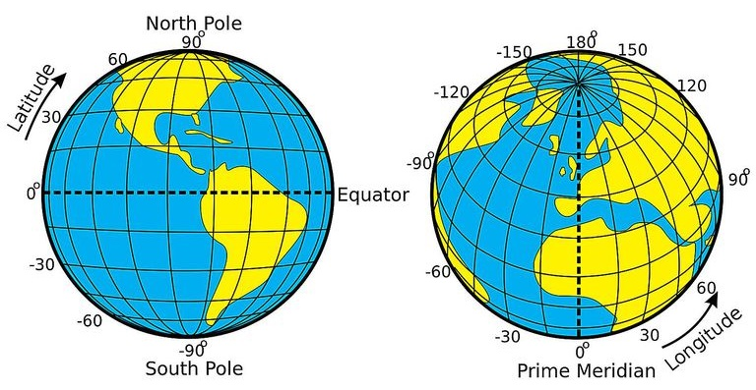
Negative Longitude
Why is longitude negative?
Longitude is defined at Greenwich, England → Everything to the East is positive (up to 180-degrees). Everything to the West is negative (also, up to 180-degrees).
Latitude → Toward North Pole is positive (up to 90-degrees). Toward South Pole is negative (also, up to 90-degrees).

Slide 36
Creating a PDF with Leaflet
Use webshot2 package
NOTE: Older versions of r use webshot’s phantom_js: webshot::phantom_js()
Take a screenshot and save to a pdf
htmlwidgets::saveWidget(leaflet_obj, "temp.html", selfcontained = FALSE) webshot("temp.html", file = “leaflet_PDF.pdf", cliprect = "viewport")
Take a screenshot and save as png
Create an img folder and
htmlwidgets::saveWidget(leaflet_obj, "temp.html", selfcontained = FALSE) webshot("temp.html", file = "img/leaflet_image.png", cliprect = "viewport")

